Slide 1
COMPUTATIONAL THINKING , PROBLEM SOLVING, ALGORITM, FLOWCHART, PSEUDOCODE, DECISION TREE TYPES OF ERRORS AND EXCEPTIONS

Slide 3
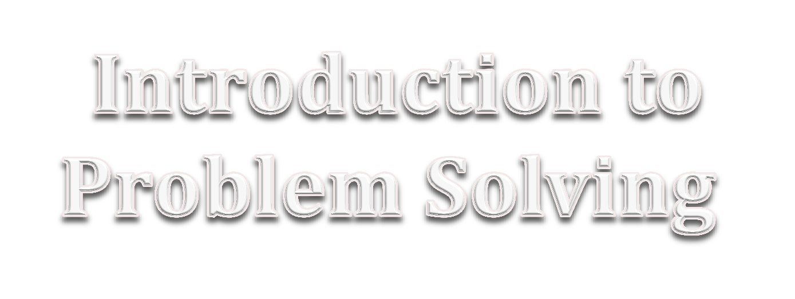

Slide 4
CONTENTS
( Learning Outcomes ) ☺
Introduction to Computational Thinking and Programming-1
Problem solving
Problem Solving Cycle
Algorithm, Flowchart, Pseudo-code
Concept of Problem Decomposition
Examples of Problem Decomposition

Slide 5
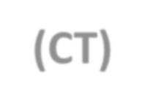
Computational Thinking (CT) is a set of problem-solving methods that involve expressing problems and their solutions in ways that a computer could also execute. It involves the mental skills and practices for designing computations that get computers to do jobs for people, and explaining and interpreting the world as a complex of information processes.

Slide 6
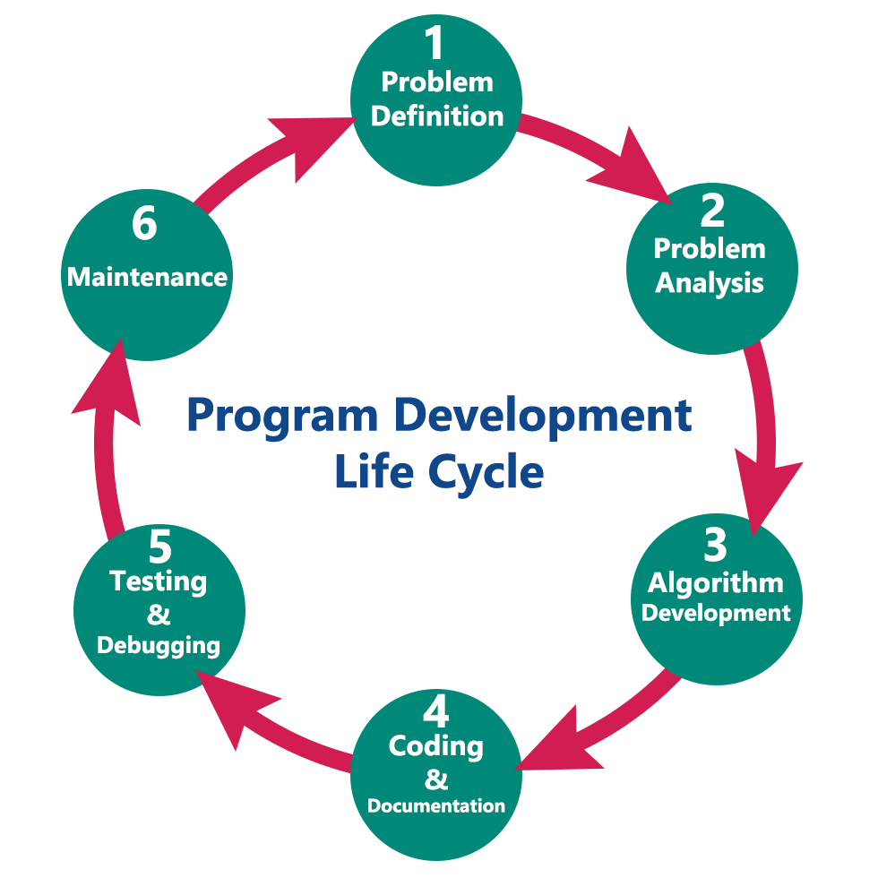
WHAT IS PROBLEM SOLVING ?
Precise step-by-step instructions given by us to solve a problem is known as Problem Solving.
Thus, problem solving is the process of identifying a problem, developing an algorithm for the identified problem and finally implementing the algorithm to develop
a computer program to solve the problem.

Slide 7
PROBLEM SOLVING METHODOLOGY AND TECHNIQUES
Steps to create a working program
Understand the problem well
Analyze the problem to
Identify minimum number of inputs required for output
Identify processing components.
design the program by
Deciding step by step solution.
Breaking down solution into simple steps.
Code the program by
Identifying arithmetic and logical operation required for solution.
Using appropriate control structure such as conditional or looping control structure.
Test and Debug your program by
Finding error in it.
Rectifying the error.
Complete your documentation.
Maintain your program.

Slide 8
PROGRAM LOGIC DEVELOPMENT TOOLS
ALGORITHM:- An algorithm is a step-by-step procedure (well-defined instructions) to solve a given problem.
Eg.
Algorithms are written out with tools like
pseudocode, flowcharts, decision trees.

Slide 9
Flowcharts
A flowchart is a graphical representation of steps of an algorithm to solve a
given problem.
START / END
PROCESS
DECISION / Condition
DATA (Input/Output)
SUB PROCESS / USER DEFINED TASK DOCUMENT

Slide 10
Start
Eg. of FLOWCHART to
determine if the first number is divisible by the second number.
Input the first number (f)
Input the second number (s)
Remainder = f%s
Is remainder==0?
YES
Display “ the first no. is
divisible by the second no.”
NO
Display “ the first no. IS NOT
divisible by the second no.”
STOP

Slide 11
PSEUDOCODE
Pseudocode is an informal way of describing the steps of a
program’s solution without using any strict programming language syntax or underlying technology considerations.
It uses simple English and highlights the sequence of instructions.
Eg. Write the pseudocode to determine is the first number is divisible by the second number or not.
Ans.
Input first number in variable firstnum.
Input second number in variable secondtnum. Remainder= firstnum modulus secondnum
If the remainder is 0
display ‘the first number is divisible by the second number’. else
display ‘the first number IS NOT divisible by the second number’.

Slide 12
DECISION TREES
Decision trees are a way of presenting rules in a hierarchical and sequential structure, where based on the hierarchy of rules, certain outcomes are predicted. Eg.
MARKS
>=60
50-60
40-50
<40
DIVISION
First Second Third Failed

Slide 13
Marks more than or equal to 60
Eg. Decision tree
NO YES
Marks more than or equal to 50
“First Division”
NO YES
Marks more than or equal to 40
“Second Division”
NO YES
“Failed”
“Third Division”

Slide 15
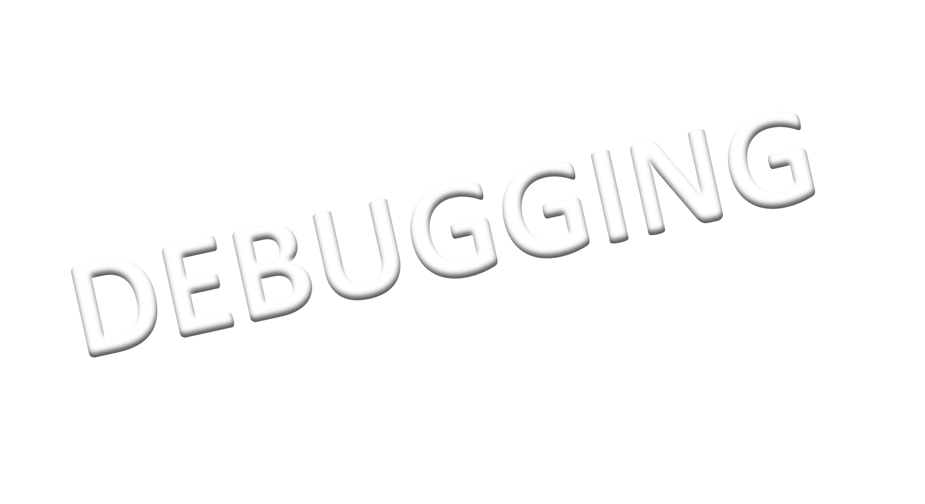

Slide 16
What is Testing and Debugging?
Testing refers to check for an error or bug in the program code.
Debugging refers to the process of locating the place of error, cause of error, and correcting the code accordingly.
→Errors
→Exceptions

Slide 17
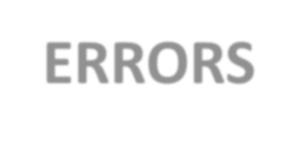
Errors and Exceptions
ERRORS | EXCEPTIONS
Error is a bug in the code that causes irregular output or stops a program from executing. Error prevents the program from compiling and running correctly. Errors in a program can be fixed by making corrections in the code. Types of Errors:- Compile time Errors Syntax Error Runtime Errors Logical Errors / Semantics Error (In few of the programming Languages) | Exception is an irregular unexpected situation occurring during execution on which programmer has no control. Fixing exception is tougher than fixing errors. Exceptions are written in try and except block. Some Built-in Exceptions are:- EOF Error IOError NameError IndexError ImportError TypeError ValueError ZeroDivisionError OverflowError KeyError

Slide 18
Types of Error
Compile Time Error- Occurs during compile time. When a program compiles, its source code is checked for whether it follows the programming language’s rules or not.
Its types are:-
Syntax Errors : it occurs when a grammatical rule of the Programming language is violated
Eg.
if a=>b print(a)
# Instead of ==(relational operator) =>
#has been used, which is syntactically wrong. #Moreover, : has not been given after the if condition.
2. Semantic errors: it occurs when statements are not meaningful.
Semantics refers to the set of rules which give the meaning of a statement.
a*b=c # Statement is not meaningful…… Semantic Error !!!!!

Slide 19
Run Time Error:
It occurs during the execution of the program. These errors are harder to detect (trap).
Some run time errors stop the execution of the program which is known as program “crashed” or “abnormally terminated”.
Eg.
An infinite loop or wrong input value (giving string instead of int, which is required)
Logical Error:
It occurs due to wrong logic of a program. We don’t encounter any error during compile-time or run-time, but still program does not provide the correct result. This is done by the programmer’s mistake.
Eg.
Trying to print the multiplication table , but instead of a*i, you have written a+i , which shows a wrong result by adding the nos. rather than multiplying.

Slide 20
Some Built – in Exceptions | Description
EOFError | Raised when one of the built-in functions (input()) hits an end-of-file condition (EOF) without reading any data.
IOError | Raised when an I/O operation (such as a print(), the built-in open() function or a method of a file object) fails for an I/O-related reason, e.g., “file not found” or “disk full”.
NameError | Raised when an identifier name is not found.
IndexError | Raised when a sequence subscript or index is out of range, e.g., from a string of length 4 if you try to read a value of index like 4 or more i.e., string[4], string[5], string[-5] etc. will raise exception as legal indexes for a string of length 4 are 0, 1, 2, 3 and -1, -2, -3, -4 only.
ImportError | Raised when an import statement fails to find the module definition or when a from_import fails to find a name that is to be imported.
TypeError | Raised when an operation or function is applied to an object of inappropriate type, e.g., if you try to compute a square-root of a string value.
ValueError | Raised when a built-in operation or function receives an argument with inappropriate value e.g., int(“z10”) will raise ValueError.
ZeroDivisionError | Raised when the second argument of a division or modulo operation is zero.
OverflowError | Raised when the result of an arithmetic operation is too large to be represented.
KeyError | Raised when a mapping (dictionary) key is not found in the set of existing keys.

Slide 21
HOW TO DEBUG A PROGRAM
Debugging involves correction of code so that the cause of errors is removed.
Testing is done to verify correct behavior i.e., with some sample values (test cases) whose output is already known, the code is tested – if it produces the anticipated output, code is correct and if it does not, there is some error. Once you know the errors, you can debug your program.
Some useful debugging techniques.
Debugging Techniques
Debugging a program is a skill. There are many traditional debugging techniques that you can allow to debug your code. These are:
Carefully spot the origin of error.
Print variables’ intermediate values.
Code tracing and stepping.

Slide 22
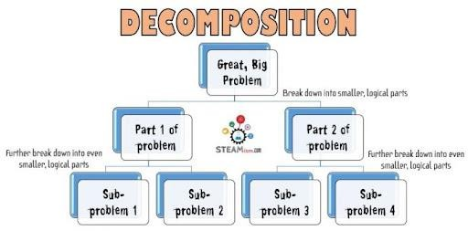
DECOMPOSITION
Decomposition involves breaking down a complex problem or system into smaller parts that are more manageable and easier to understand.
The smaller parts can then be examined and solved, or designed individually, as they are simpler to work with.

Slide 23
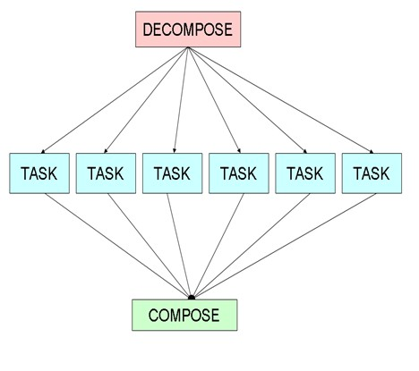
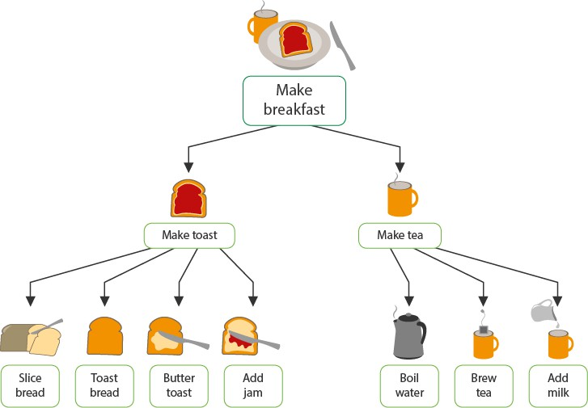
EXAMPLES OF DECOMPOSITION

Slide 24
Stay safe. Stay aware. Stay healthy. Stay alert.

